Slide 1

NAT(Network Address Translation)
网络地址转换

Slide 2
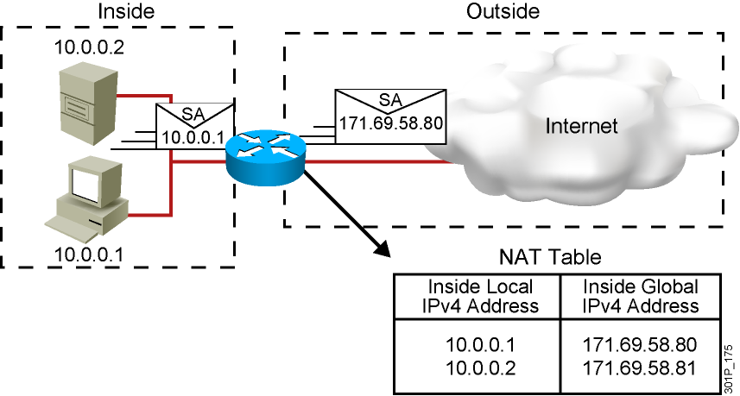
NAT-网络地址转换
An IP address is either local or global.
Local IPv4 addresses are seen in the inside network.
Global IPv4 addresses are seen in the outside network.

Slide 3
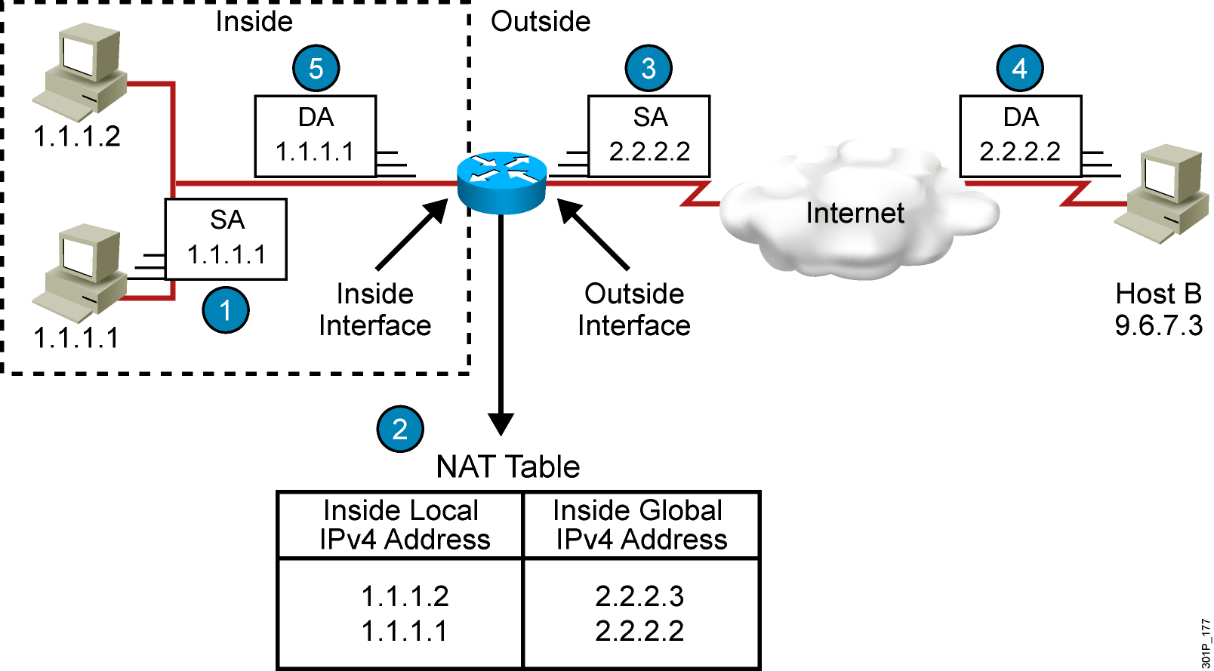
NAT地址转换的具体过程

Slide 4



NAT术语
内部本地 | 转换之前内部源地址的名字
外部本地 | 转换之前目标主机的名字
内部全局 | 转换之后内部主机的名字
外部全局 | 转换之后外部目标主机的名字
inside
outside
outside
inside
Internet
内部本地
内部全局
外部全局
外部本地

Slide 5
NAT三种类型
1 静态NAT
  将内部本地地址与内部全局地址进行一对一的明确转换。这种方法主要用在内部网络中有对外提供服务的服务器，如WEB、MAIL服务器时。该方法的缺点是需要独占宝贵的合法IP地址。即，如果某个合法IP地址已经被NAT静态地址转换定义，即使该地址当前没有被使用，也不能被用作其它的地址转换。

Slide 6
配置静态NAT转换
Router(config)# ip nat inside source static local-ip global-ip
Establishes static translation between an inside local address and an
inside global address
Router(config-if)# ip nat inside
Marks the interface as connected to the inside
Router(config-if)# ip nat outside
Marks the interface as connected to the outside
Router# show ip nat translations
Displays active translations

Slide 7
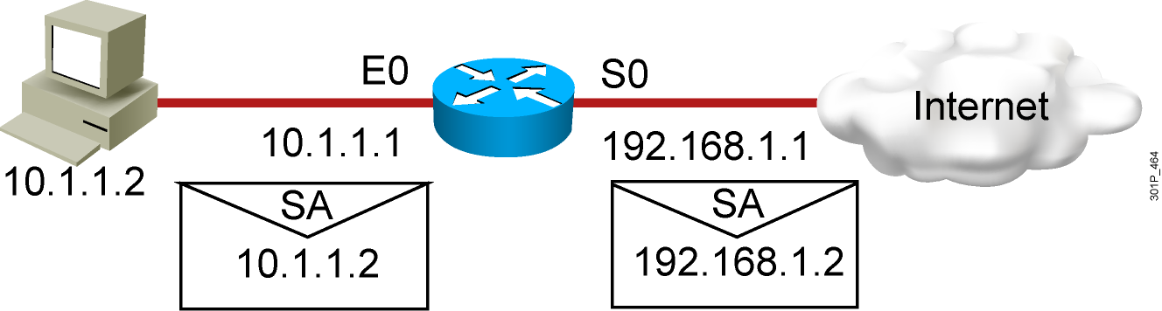
配置静态NAT转换-举例
interface s0
ip address 192.168.1.1 255.255.255.0
ip nat outside
!
interface e0
ip address 10.1.1.1 255.255.255.0
ip nat inside
!
ip nat inside source static 10.1.1.2 192.168.1.2
Router# show ip nat translations
Pro Inside global Inside local Outside local Outside global
--- 192.168.1.2 10.1.1.2 --- ---

Slide 8
NAT三种类型
2 动态NAT
  动态地址转换也是将内部本地地址与内部全局地址进行一对一的转换。但是，是从内部全局地址池中动态地选择一个未使用的地址对内部本地地址进行转换。该地址是由未被使用的地址组成的地址池中在定义时排在最前面的一个。当数据传输完毕后，路由器将把使用完的内部全局地址放回到地址池中，以供其它内部本地地址进行转换。但是在该地址被使用时，不能用该地址再进行一次转换。

Slide 9
配置动态NAT转换
Router(config)# ip nat pool name start-ip end-ip
{netmask netmask | prefix-length prefix-length}
Defines a pool of global addresses to be allocated as needed
Router(config)# access-list access-list-number permit
source [source-wildcard]
Defines a standard IP ACL permitting those inside local addresses
that are to be translated
Router(config)# ip nat inside source list
access-list-number pool name
Establishes dynamic source translation, specifying the ACL that was
defined in the previous step
Router# show ip nat translations
Displays active translations

Slide 10
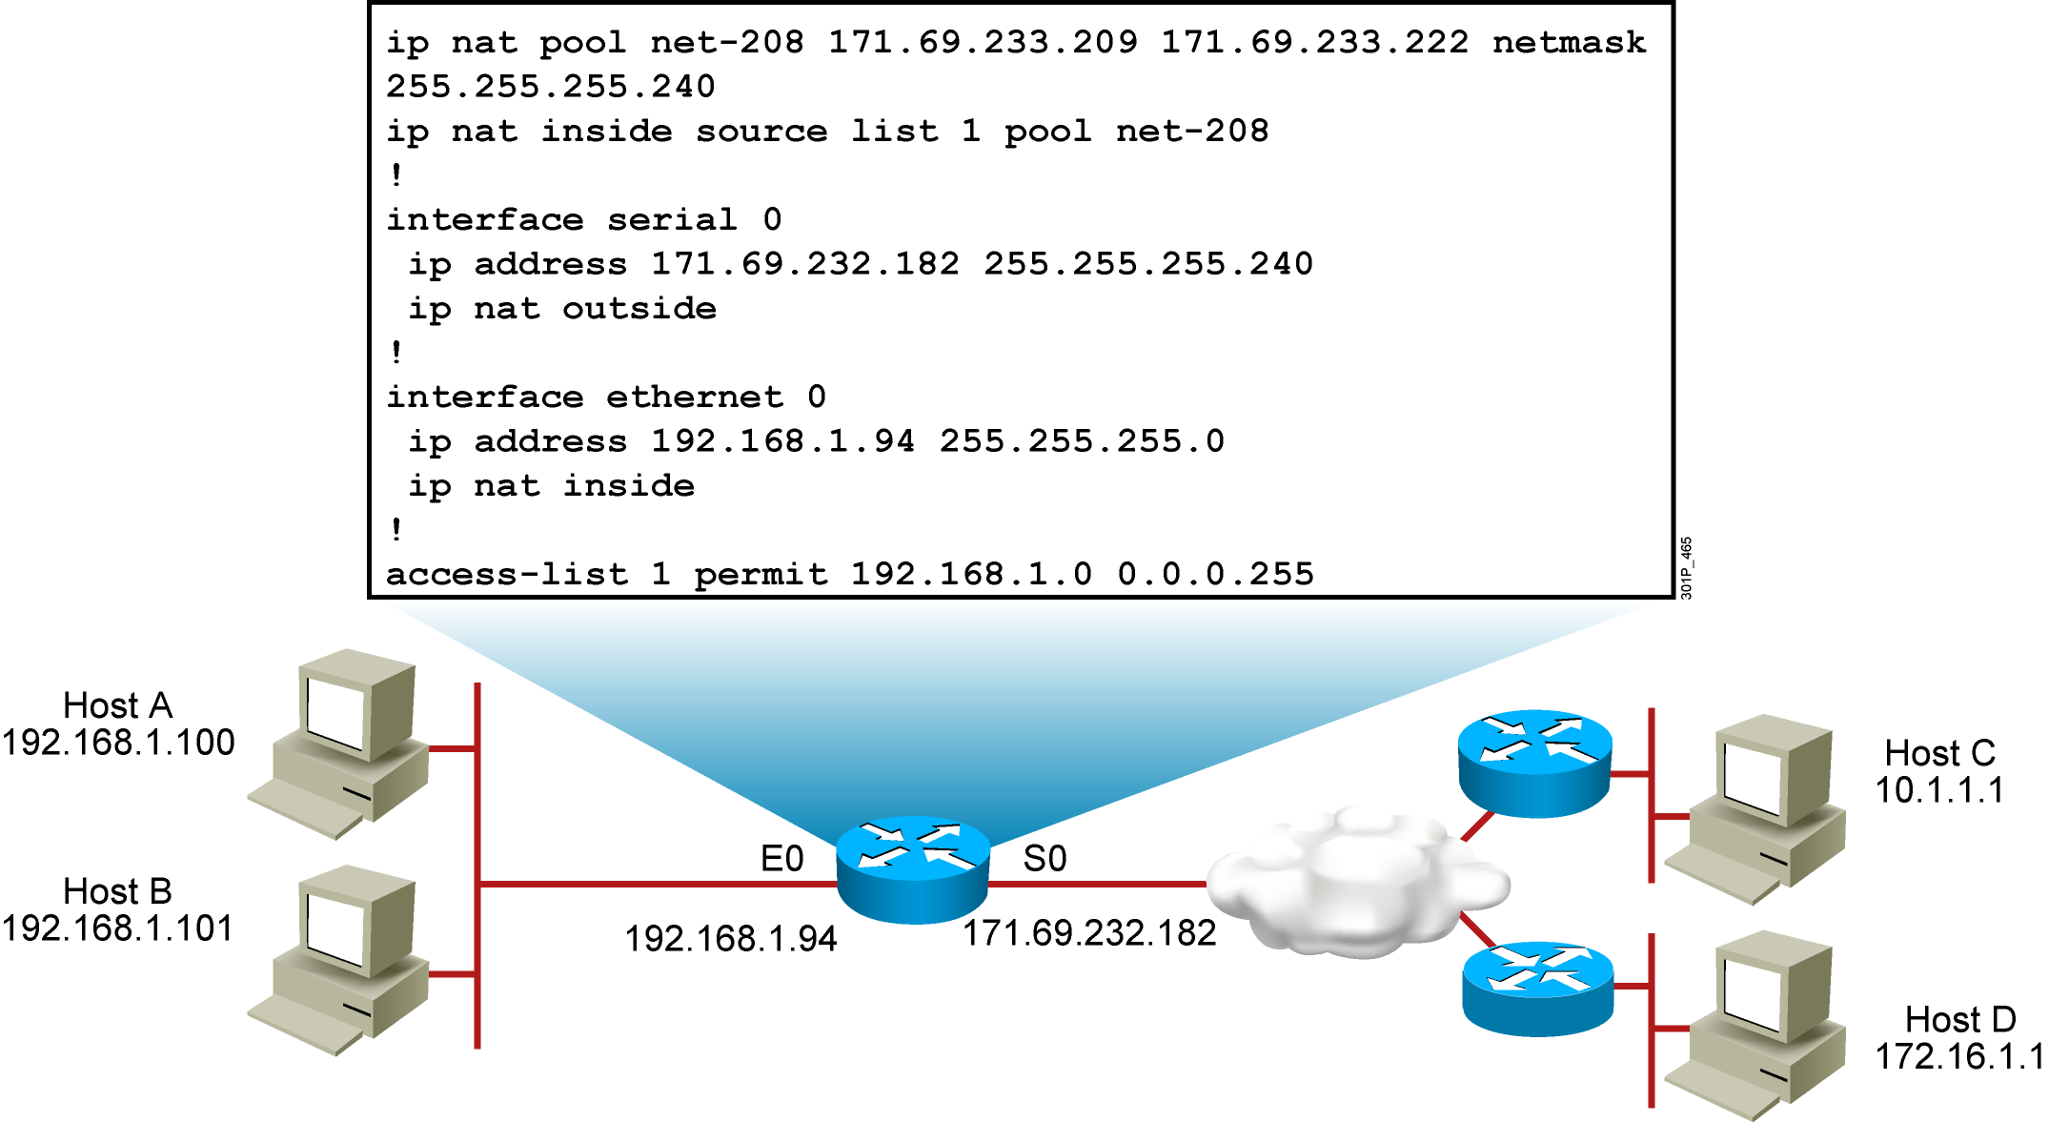
配置动态NAT转换-举例
Router# show ip nat translations
Pro Inside global Inside local Outside local Outside global
--- 171.69.233.209 192.168.1.100 --- ---
--- 171.69.233.210 192.168.1.101 --- ---

Slide 11
NAT三种类型
3 端口复用
  复用地址转换也称为端口地址转换（Port Address Translation，PAT），首先是一种动态地址转换。路由器将通过记录地址、应用程序端口等唯一标识一个转换。通过这种转换，可以使多个内部本地地址同时与同一个内部全局地址进行转换并对外部网络进行访问。对于只申请到少量IP地址甚至只有一个合法IP地址，却经常有很多用户同时要求上网的情况，这种转换方式非常有用
  理想状况下，一个单一的IP地址可以使用的端口数为4000个

Slide 12
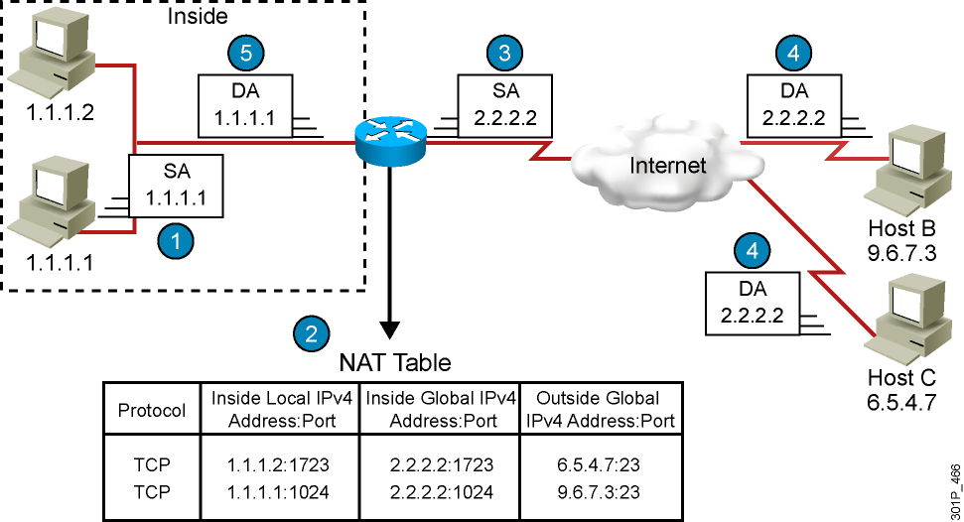
理解PAT地址转换(Overloading)

Slide 13
配置PAT地址转换(Overloading)
Router(config)# access-list access-list-number permit
source source-wildcard
Defines a standard IP ACL that will permit the inside local addresses
that are to be translated
Router(config)# ip nat inside source list
access-list-number interface interface overload
Establishes dynamic source translation, specifying the ACL that was
defined in the previous step
Router# show ip nat translations
Displays active translations

Slide 14
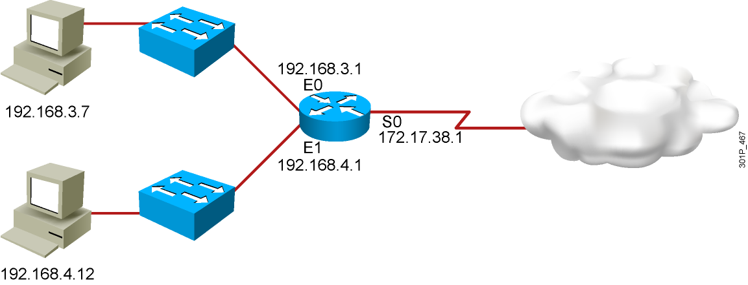
配置PAT地址转换(Overloading)-举例
hostname Router
!
interface Ethernet0
ip address 192.168.3.1 255.255.255.0
ip nat inside
!
interface Ethernet1
ip address 192.168.4.1 255.255.255.0
ip nat inside
!
interface Serial0
description To ISP
ip address 172.17.38.1 255.255.255.0
ip nat outside
!
ip nat inside source list 1 interface Serial0 overload
!
ip route 0.0.0.0 0.0.0.0 Serial0
!
access-list 1 permit 192.168.3.0 0.0.0.255
access-list 1 permit 192.168.4.0 0.0.0.255
!
Router# show ip nat translations
Pro Inside global Inside local Outside local Outside global
TCP 172.17.38.1:1050 192.168.3.7:1050 10.1.1.1:23 10.1.1.1:23
TCP 172.17.38.1:1776 192.168.4.12:1776 10.2.2.2:25 10.2.2.2:25

Slide 15
清除NAT 转换表项
Router# clear ip nat translation *
Clears all dynamic address translation entries
Router# clear ip nat translation inside global-ip
local-ip [outside local-ip global-ip]
Clears a simple dynamic translation entry that contains an inside
translation or both an inside and outside translation
Router# clear ip nat translation outside
local-ip global-ip
Clears a simple dynamic translation entry that contains an outside
translation
Router# clear ip nat translation protocol inside global-ip
global-port local-ip local-port [outside local-ip
local-port global-ip global-port]
Clears an extended dynamic translation entry (PAT entry)

Slide 16
问题：在NAT表中没有转换项
Verify that:
  There are no inbound ACLs that are denying the packets entry to the NAT router
  The ACL referenced by the NAT command is permitting all necessary networks
  There are enough addresses in the NAT pool
  The router interfaces are appropriately defined as NAT inside or NAT outside
Notes:
配置是否正确
看路由器的入站方向是否有ACL拒绝条目的存在
看源访问列表是否设置正确
NAT地支持是否有足够的地址
在相应的接口上是否正确设置了ip nat inside 或者ip nat outside

Slide 17
显示相关的转换信息： debug and show 命令
Router# debug ip nat
NAT: s=192.168.1.95->172.31.233.209, d=172.31.2.132 [6825]
NAT: s=172.31.2.132, d=172.31.233.209->192.168.1.95 [21852]
NAT: s=192.168.1.95->172.31.233.209, d=172.31.1.161 [6826]
NAT*: s=172.31.1.161, d=172.31.233.209->192.168.1.95 [23311]
NAT*: s=192.168.1.95->172.31.233.209, d=172.31.1.161 [6827]
NAT*: s=192.168.1.95->172.31.233.209, d=172.31.1.161 [6828]
NAT*: s=172.31.1.161, d=172.31.233.209->192.168.1.95 [23312]
NAT*: s=172.31.1.161, d=172.31.233.209->192.168.1.95 [23313]
Router# show ip nat statistics
Total active translations: 1 (1 static, 0 dynamic; 0 extended)
Outside interfaces:
Ethernet0, Serial2
Inside interfaces:
Ethernet1
Hits: 5 Misses: 0
…

Slide 18
问题：NAT表中存在转换项，但是没有被使用
Verify:
  What the NAT configuration is supposed to accomplish
  That the NAT entry exists in the translation table and that it is accurate
  That the translation is actually taking place by monitoring the NAT process or statistics
  That the NAT router has the appropriate route in the routing table if the packet is going from inside to outside
  That all necessary routers have a return route back to the translated address

Slide 19
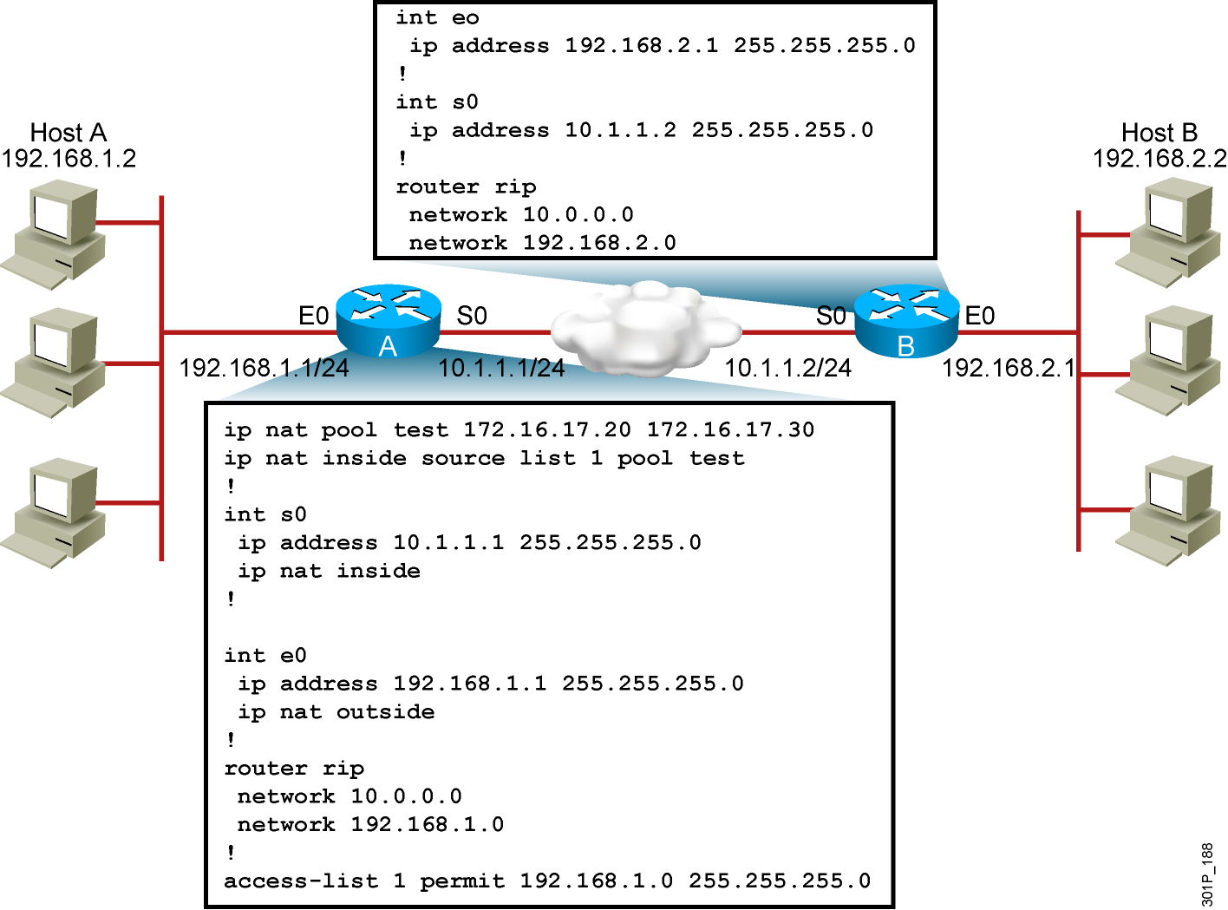
问题: 不能ping通远程的主机

Slide 20
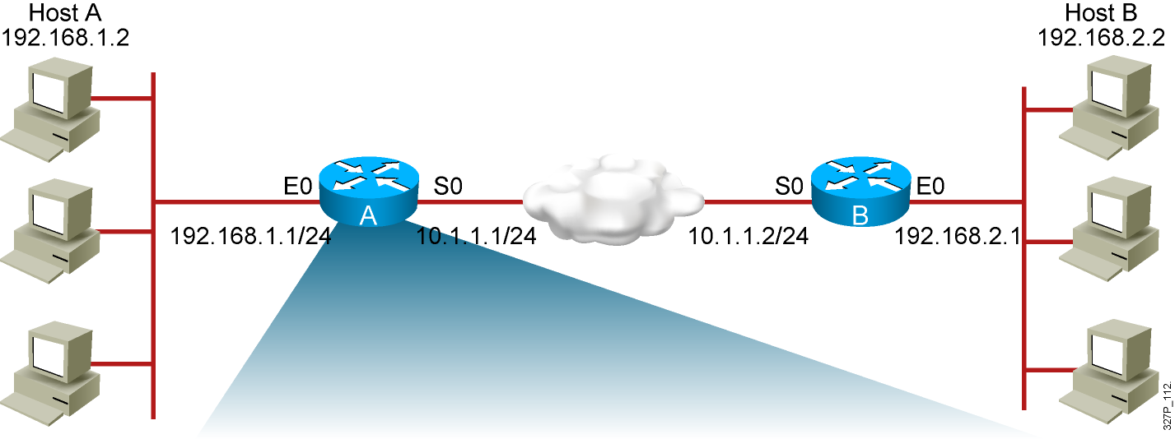
RouterA# show ip nat translations
Pro Inside global Inside local Outside local Outside global
--- --- ---
--- --- ---
There are no translations in the table.

Slide 21
RouterA# show ip nat statistics
Total active translations: 0 (0 static, 0 dynamic; 0 extended)
Outside interfaces:
Ethernet0
Inside interfaces:
Serial0
Hits: 0 Misses: 0
…
The router interfaces are inappropriately defined as NAT inside and NAT outside.

Slide 22
RouterA# show access-list
Standard IP access list 20
10 permit 0.0.0.0, wildcard bits 255.255.255.0
Pings are still failing and there are still no translations in the table.
There is an incorrect wildcard bit mask in the ACL that defines
the addresses to be translated.

Slide 23
RouterA# show ip nat translations
Pro Inside global Inside local Outside local Outside global
--- 172.16.17.20 192.168.1.2 --- ---
Translations are now occurring.
Pings are still failing.

Slide 24
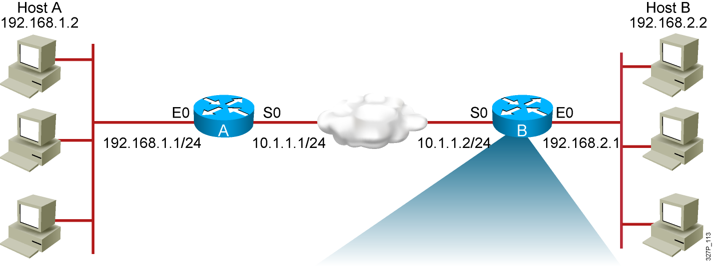
RouterB# sh ip route
Codes: C - connected, S - static, R - RIP, M - mobile, B - BGP
Gateway of last resort is not set
10.0.0.0/24 is subnetted, 1 subnets
C 10.1.1.0/24 is directly connected, Serial0
192.168.2.0/24 is subnetted, 1 subnets
R 192.168.2.0/24 is directly connected, Ethernet0
192.168.1.0/24 is variably subnetted, 3 subnets, 2 masks
R 192.168.1.0/24 [120/1] via 10.1.1.1, 2d19h, Serial0
Router B has no route to the translated network address of 172.16.0.0.

Slide 25
RouterA# sh ip protocol
Routing Protocol is "rip"
Outgoing update filter list for all interfaces is not set
Incoming update filter list for all interfaces is not set
Sending updates every 30 seconds, next due in 0 seconds
Invalid after 180 seconds, hold down 180, flushed after 240
Redistributing: rip
Default version control: send version 1, receive any version
Automatic network summarization is in effect
Maximum path: 4
Routing for Networks:
192.168.0.0
Routing Information Sources:
Gateway Distance Last Update
Distance: (default is 120)
Router A is advertising the network that is being translated, 192.168.1.0,
instead of the network address the router is translating into,172.16.0.0.

Slide 26
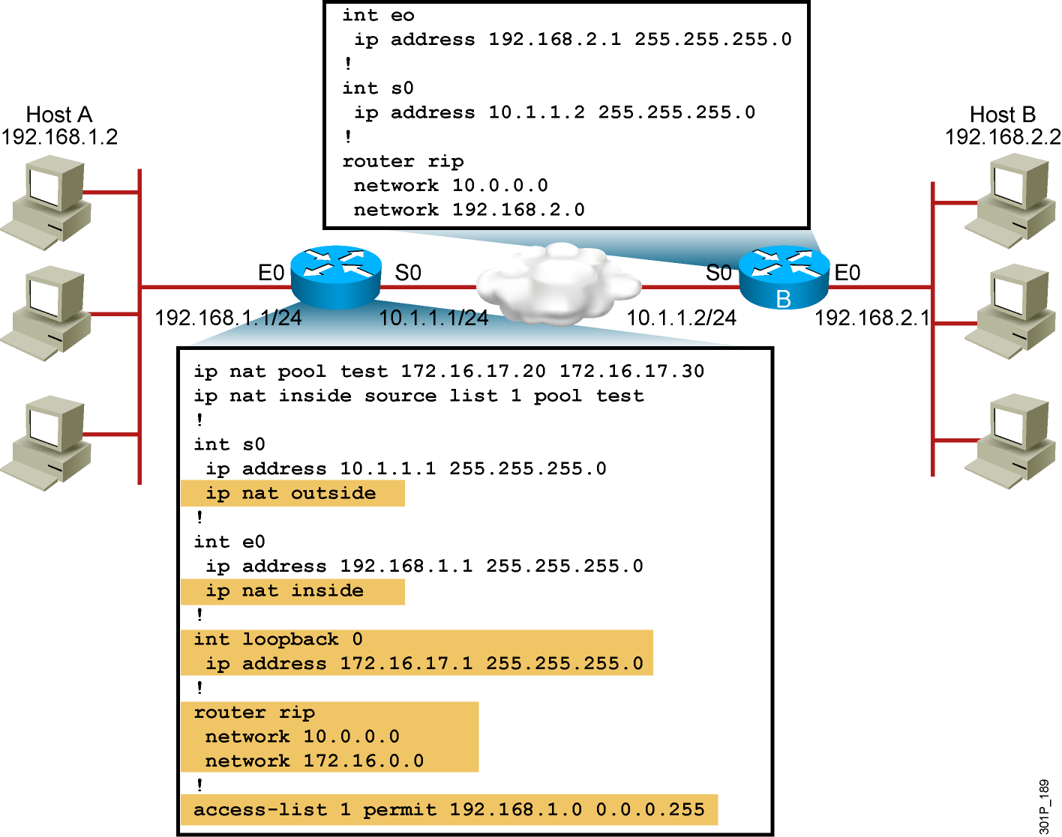
解决方法: 正确的配置如下

